Slide 1
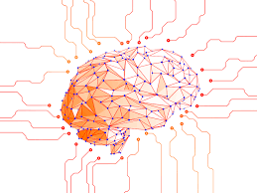
CAT IMAGE CLASSIFICATION WITH ARTIFICIAL NEURAL NETWORKS
Under the guidance of
Prof. Y.N. Singh
Dr. Aditi Sharma
By
Abhinav Yadav (1805231001)
Ayush Verma (1805231018)
Vaibhav Jaiswal (1805210061)
Group - 4

Slide 2
PROBLEM STATEMENT
Image Classification is grown extensively in the recent years and is now an emerging field in computer vision technology. It’s been widely used in various applications and devices to classify various objects and to also classify those objects based on their certain behaviours. Image classification can be used for detecting various animals such as cats, dogs, birds, etc . Scientifically it can be used for detecting and classifying any new species discovered. It can be also used to classify different breeds among the same species.
Here in this project we are implementing cat image classifier using artificial neural network applying supervised learning, forward propagation, back propagation and optimization.

Slide 3
MOTIVATION
Motivation for making this project comes from the fact that as
we all know that at certain times in our country wild animals like lions, leopards, etc. enter the cities and lead to disturbance in life of human beings. So for this purpose we can use this project for real-time tracking of such animals if at the borders of heavily populated cities so that they can be traced and cached as early as possible.
Another usage can be done for the security of domestic animals and pets. Because human being is not able to keep an eye on his/her pet for 24 hrs.

Slide 4
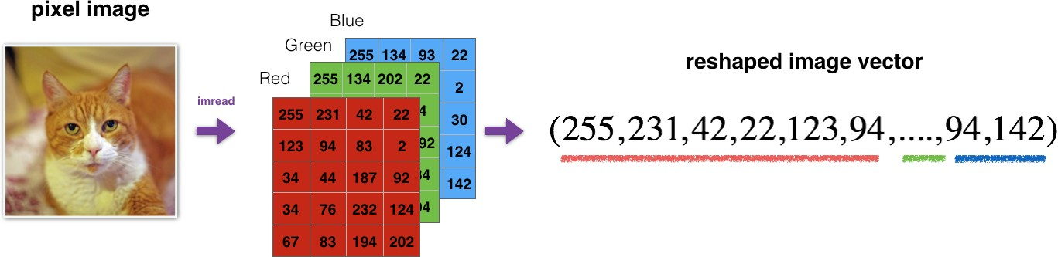
CONCEPT OF IMAGE CLASSIFICATION
Image Classification – assigning pixels in the image to categories or classes of interest.
Examples – waterbody, bare soil, cloud, shadow, rocky areas, cat-dog images etc.

Slide 5
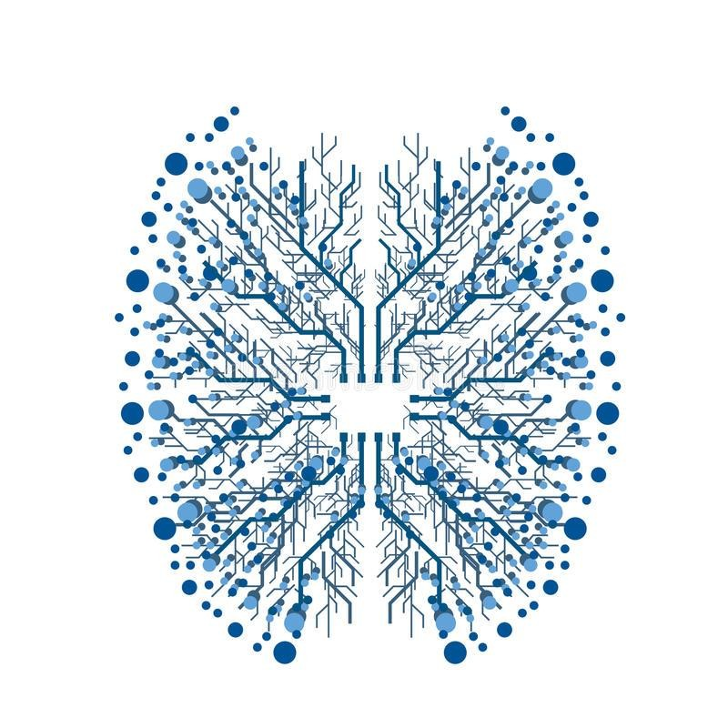
NEURAL NETWORK
Computational models inspired by the human brain:
Massively parallel, distributed system, made up of simple processing units (neurons)
Synaptic connection strengths among neurons are used to store the acquired knowledge.
Knowledge is acquired by the network from its environment through a learning process
Fault tolerance
if one of the neurons or connections is damaged, the whole network still works quite well
Thus, they might be better alternatives than classical solutions for problems characterized by:
high dimensionality, noisy, imprecise or imperfect data; and–a lack of a clearly stated
mathematical solution or algorithm

Slide 6
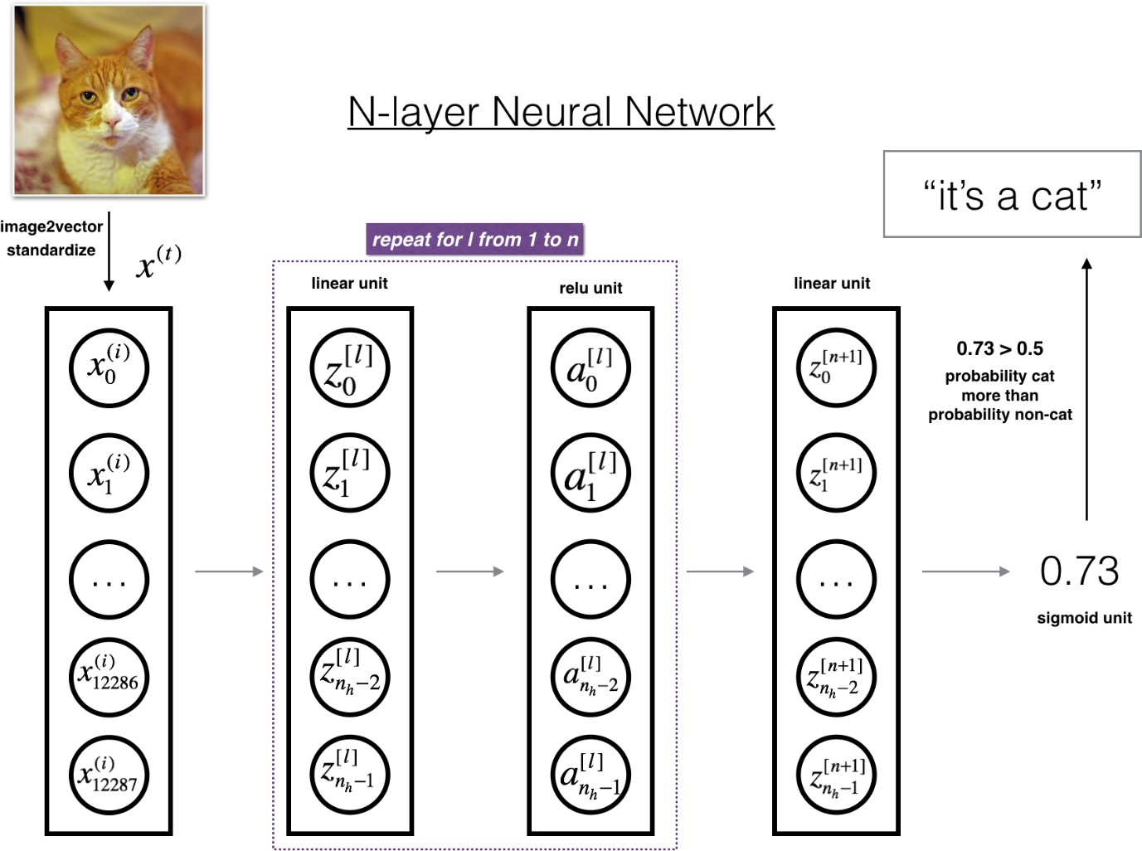
CAT IMAGE CLASSIFICATION MODEL

Slide 7
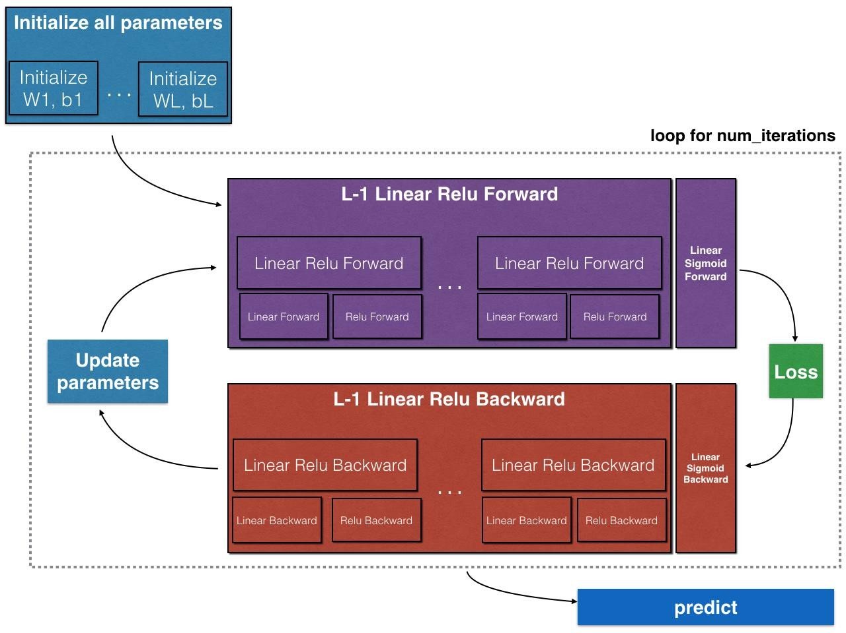
STRUCTURE OF MODEL

Slide 8
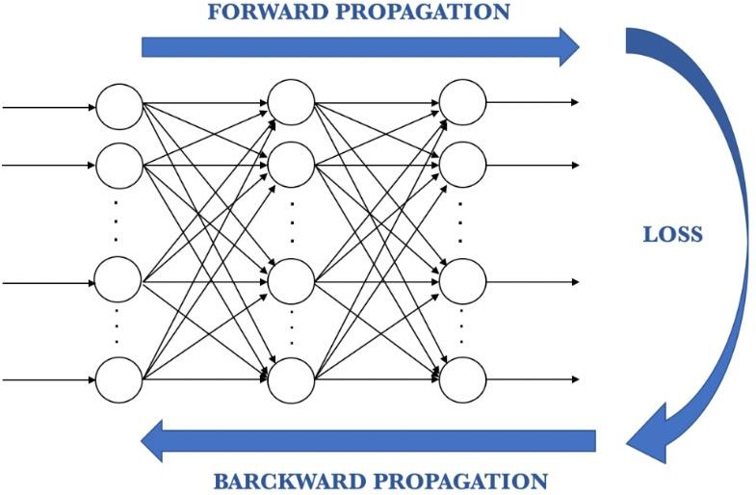
PLAN OF WORK (PHASE – 1) FORWARD PROPAGATION
The first phase forwardpropagation occurs when the network is exposed to the training data and these cross the entire neural network for their predictions (labels) to be calculated. We use the activation functions to propagate the output of a neuron forward. This output is received by the neurons of the next layer to which this neuron is connected (up to the output layer included).
The activation function serves to introduce non-
linearity in the modeling capabilities of the network.
Popular activation functions are –
Sigmoid
ReLU
tanh

Slide 9
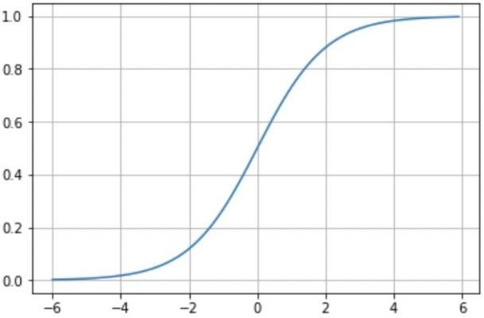
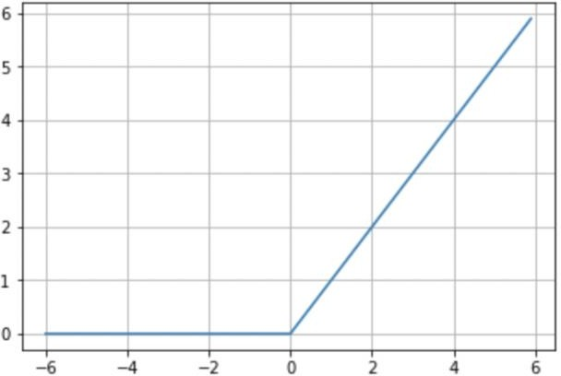
PLAN OF WORK (PHASE – 1) ACTIVATION FUNCTIONS
Sigmoid
Its interest lies in the fact that it allows a reduction in extreme or atypical values in valid data without eliminating them: it converts independent variables of almost infinite range into simple probabilities between 0 and 1.
Most of its output will be very close to the extremes of 0 or 1.
ReLU
The activation function rectified linear unit (ReLU) is a very interesting transformation that activates a single node if the input is above a certain threshold. The default and more usual behavior is that, as long as the input has a value below zero, the output will be zero but, when the input rises above, the output is a linear relationship with the input variable of the form f(x)=x. The ReLU activation function has proven to work in many different situations and is currently widely used.

Slide 10
PLAN OF WORK (PHASE – 2) BACK PROPAGATION
In summary, we can consider backpropagation as a method to alter the parameters (weights and biases) of the neural network in the right direction. It starts by calculating the loss term first, and then the parameters of the neural network are adjusted in reverse order with an optimization algorithm taking into account this calculated loss.
Loss function
A loss function is one of the parameters required to quantify how close a particular neural network is to the ideal weight during the training process.

Slide 11

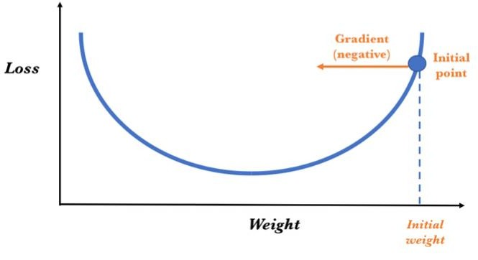
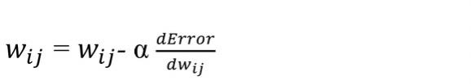
PLAN OF WORK (PHASE – 3) OPTIMIZING OUTPUT
Gradient descent
Gradient descent uses the first derivative (gradient) of the loss function when updating the parameters. Remember that the gradient gives us the slope of a function at that point. Without being able to go into detail, the process consists in chaining the derivatives of the loss of each hidden layer from the derivatives of the loss of its upper layer, incorporating its activation function
in the calculation (that’s why the activation functions must be derivable).
Learning Rate
In a more formal way, the backpropagation algorithm computes how the error changes with respect to each weight:
In order to update each weight of the network using a simple update rule:

Slide 12
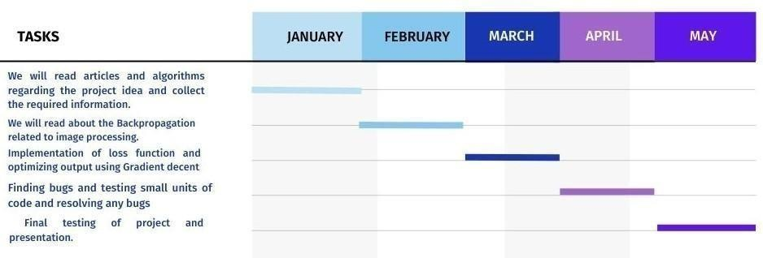
GANTT CHART

Slide 13
CONCLUSION
Start with values (often random) for the network parameters (wij weights and bj
biases).
Take a set of examples of input data and pass them through the network to
obtain their prediction.
Compare these predictions obtained with the values of expected labels and calculate the loss with them.
Perform the backpropagation in order to propagate this loss to each and every one of the parameters that make up the model of the neural network.
Use this propagated information to update the parameters of the neural network
with the gradient descent in a way that the total loss is reduced and a better model is obtained.
Continue iterating in the previous steps until we consider that we have a good model.

Slide 14
REFERENCES
1. Convolutional Neural Networks (CNN) With TensorFlow by Sourav from Edureka[https://www.youtube.com/watch?v=umGJ30-15_A]
2. Journal on Convoluted Neural Network by IIIT,Hyderabad.
3. M Manoj Krishna, M Neelima, M Harshali, M Venu Gopala Rao. Image Classification using Deep Learning. International Journal of Engineering and Technology, 7 (2.7) (2018) 614-617.
4. Xin and Wang EURASIP Journal on Image and Video Processing (2019) 2019:4
5. Mohd Azlan Abu1, Nurul Hazirah Indra1, Abdul Halim Abd Rahman1, Nor Amalia Sapiee1 and Izanoordina Ahmad. A Study on Image Classification on Deep Learning and Tensorflow. International Journal on Engineering research and Technology. (2019) pp-563 569.

Slide 15
THANK YOU

